Slide 1
Model predictive control
Prof. Davide M. Raimondo
Università degli Studi di Pavia
davide.raimondo@unipv.it

Slide 2
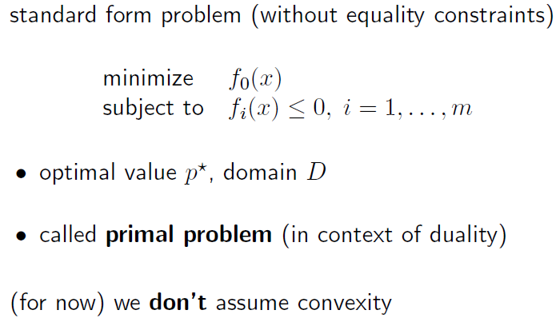
duality

Slide 3
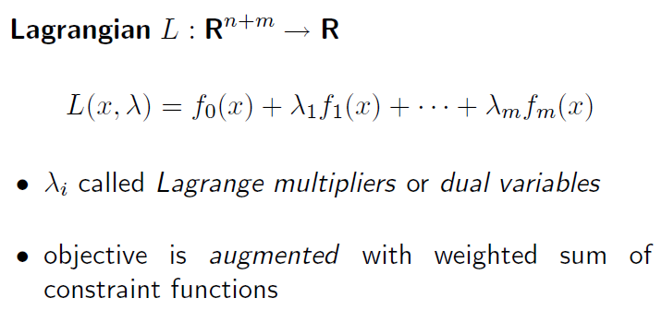
duality

Slide 4
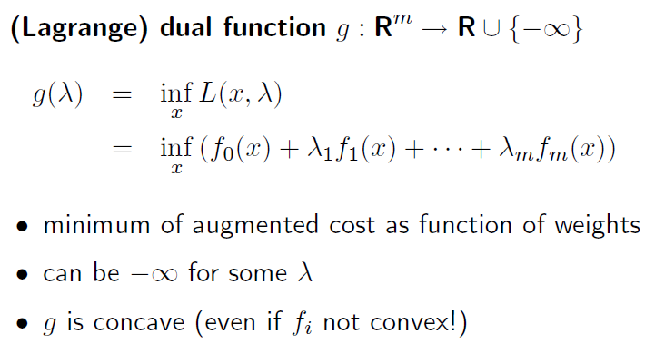
Lagrange dual function

Slide 5
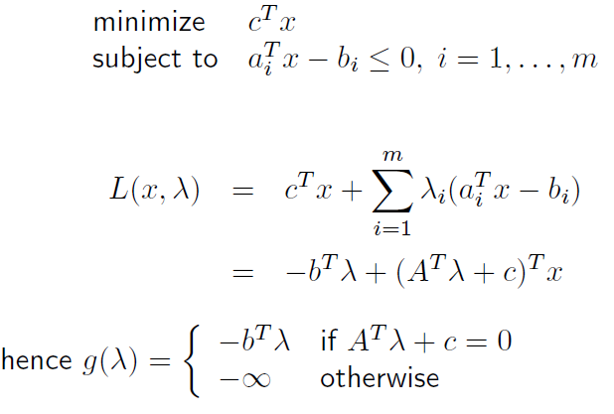
Lagrange dual function: example

Slide 6
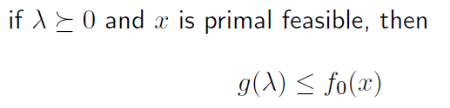
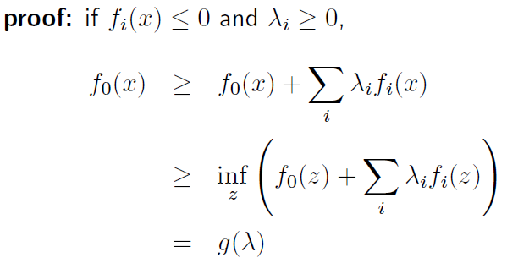
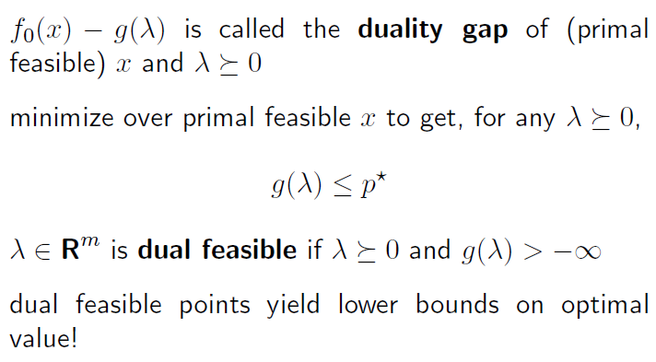
Lower bound property

Slide 7
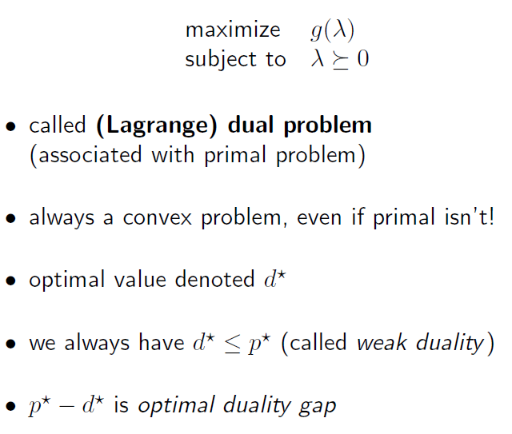
Lagrangian dual problem

Slide 8
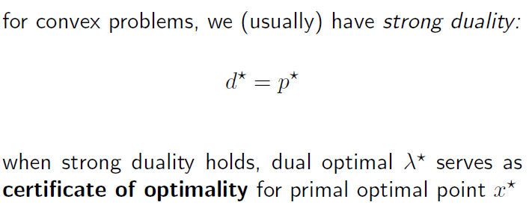
Strong duality

Slide 9
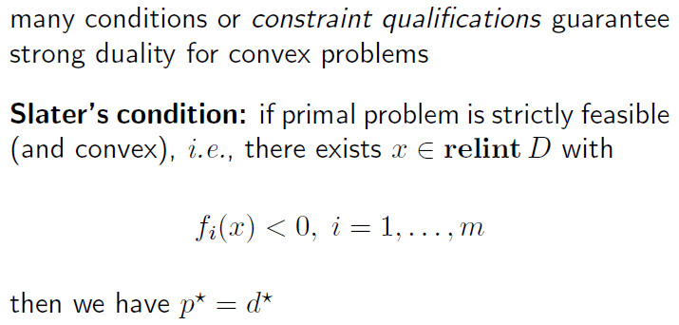
Strong duality

Slide 10
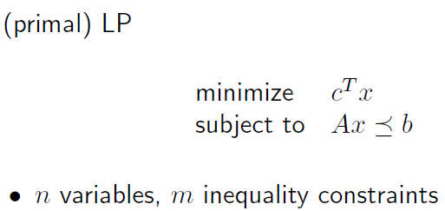
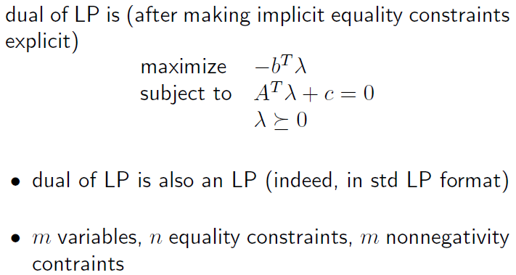
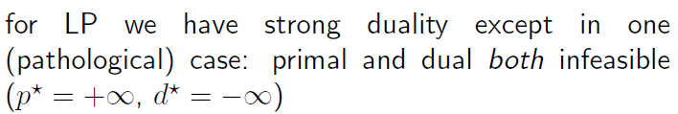
Dual of linear program

Slide 11
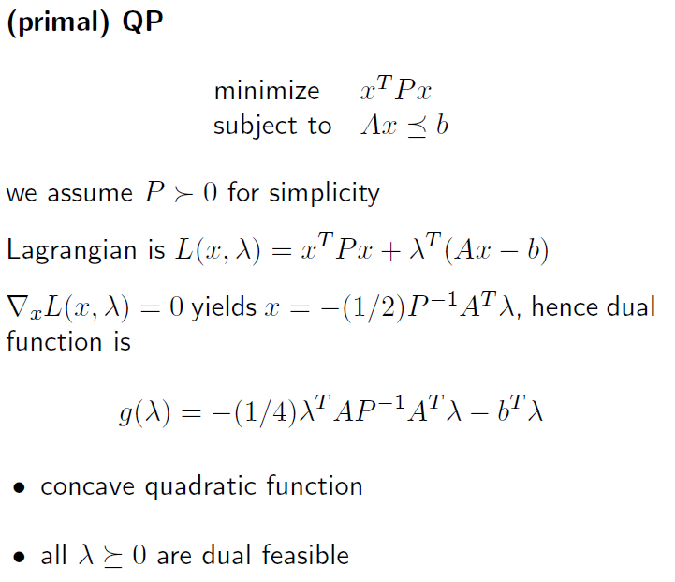
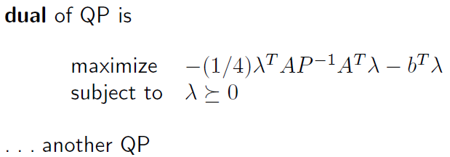
Dual of quadratic program

Slide 12
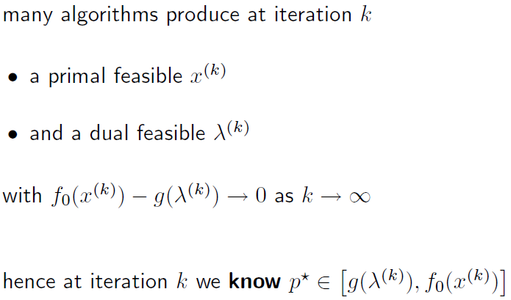
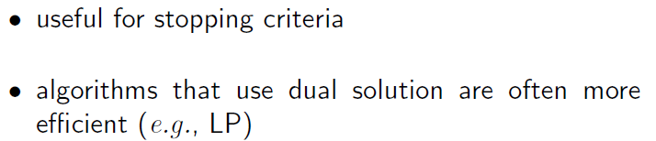
Duality in algorithms

Slide 13
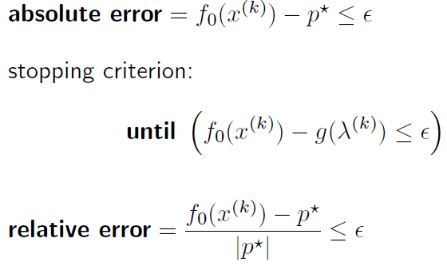
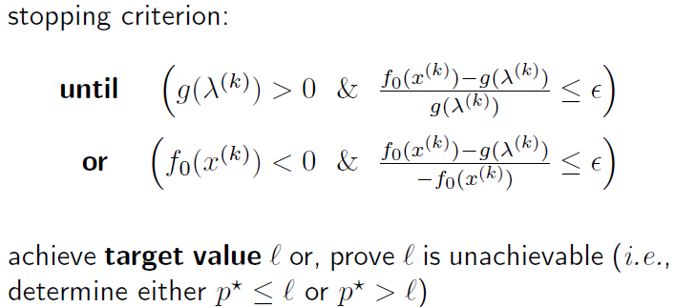
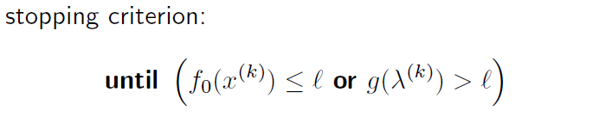
Stopping criteria

Slide 14
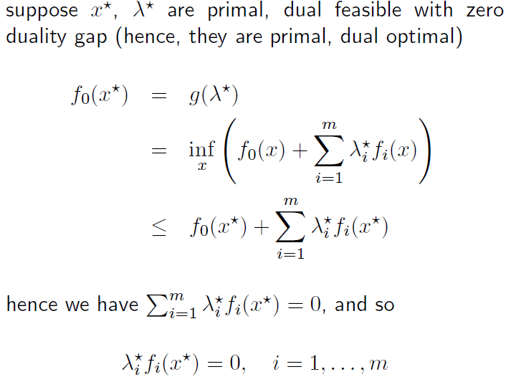
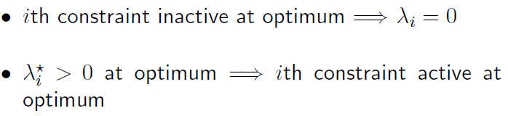
Complementary slackness condition

Slide 15
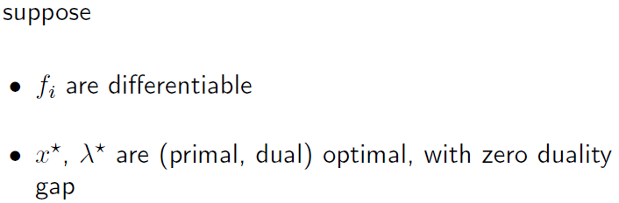
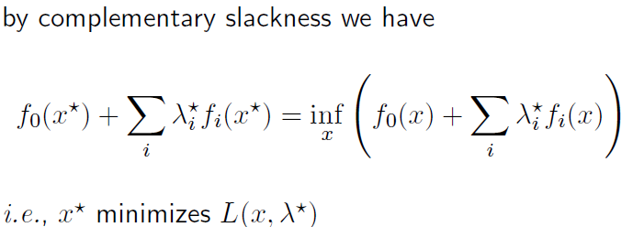

Kkt optimality conditions

Slide 16

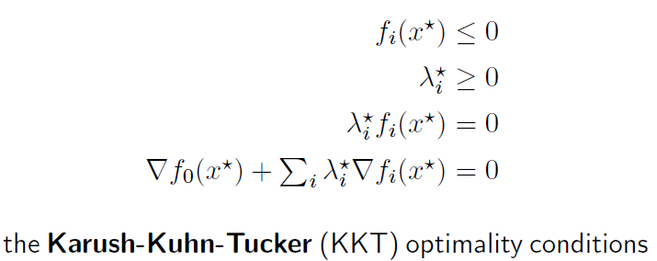
Kkt optimality conditions

Slide 17
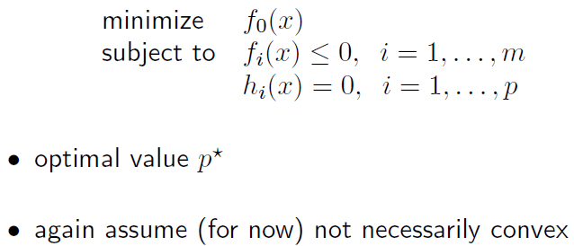
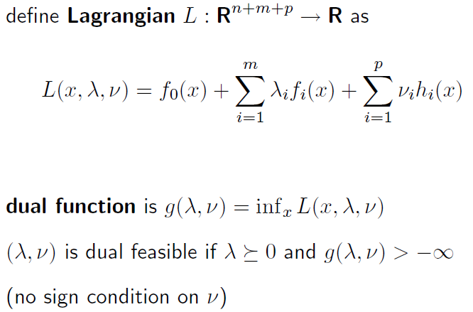
Equality constraints

Slide 18
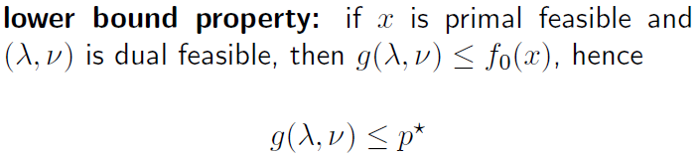
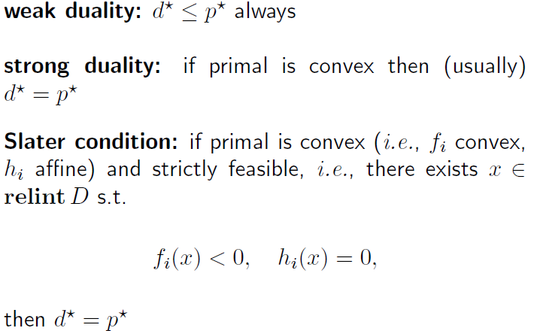
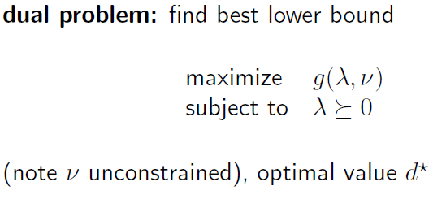
properties

Slide 19
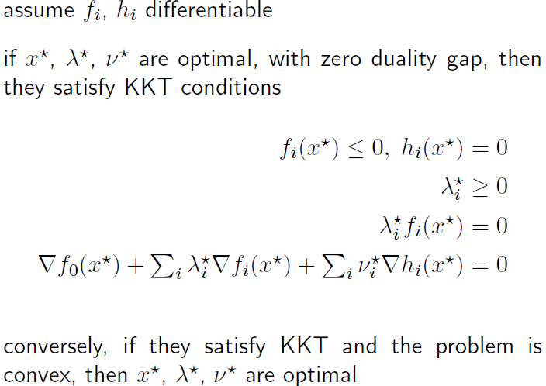
Kkt optimality conditions

Slide 20
EXPLICIT MPC

Slide 21

Model predictive control
MPC requires to solve a constrained optimization problem at each time step (Receding horizon)
Application of MPC limited to ‘slow processes’, e.g. chemical plants
Sampling time compatible with the time required to solve the optimization
Difficult to estimate the time required to solve the optimization
Online optimization requires expensive and often bulky hardware
Find a way to solve the optimization off-line for each possible initial condition

Slide 22


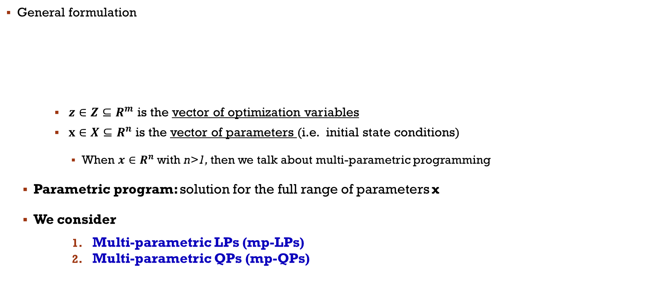
Parametric programming
General formulation
$z∈Z{⊆R}^{m}$ is the vector of optimization variables
$x∈X{⊆R}^{n}$ is the vector of parameters (i.e. initial state conditions)
When ${x∈R}^{n}$ with n>1, then we talk about multi-parametric programming
Parametric program: solution for the full range of parameters x
We consider
Multi-parametric LPs (mp-LPs)
Multi-parametric QPs (mp-QPs)

Slide 23
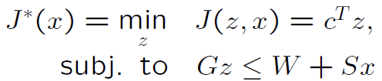
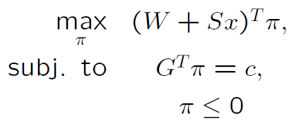

mp-LP
Formulation: given $c∈R^{m},G∈R^{q×m}$, $S∈R^{q×n}$, $W∈R^{q}$
Primal problem Dual problem
KKT Conditions
${Gz−Sx−W≤0}^{}$
$π≤0$
${(Gz−Sx−W)}^{⊺}{π=0}^{}$
$G^{⊺}π{=c}^{}$

Slide 24




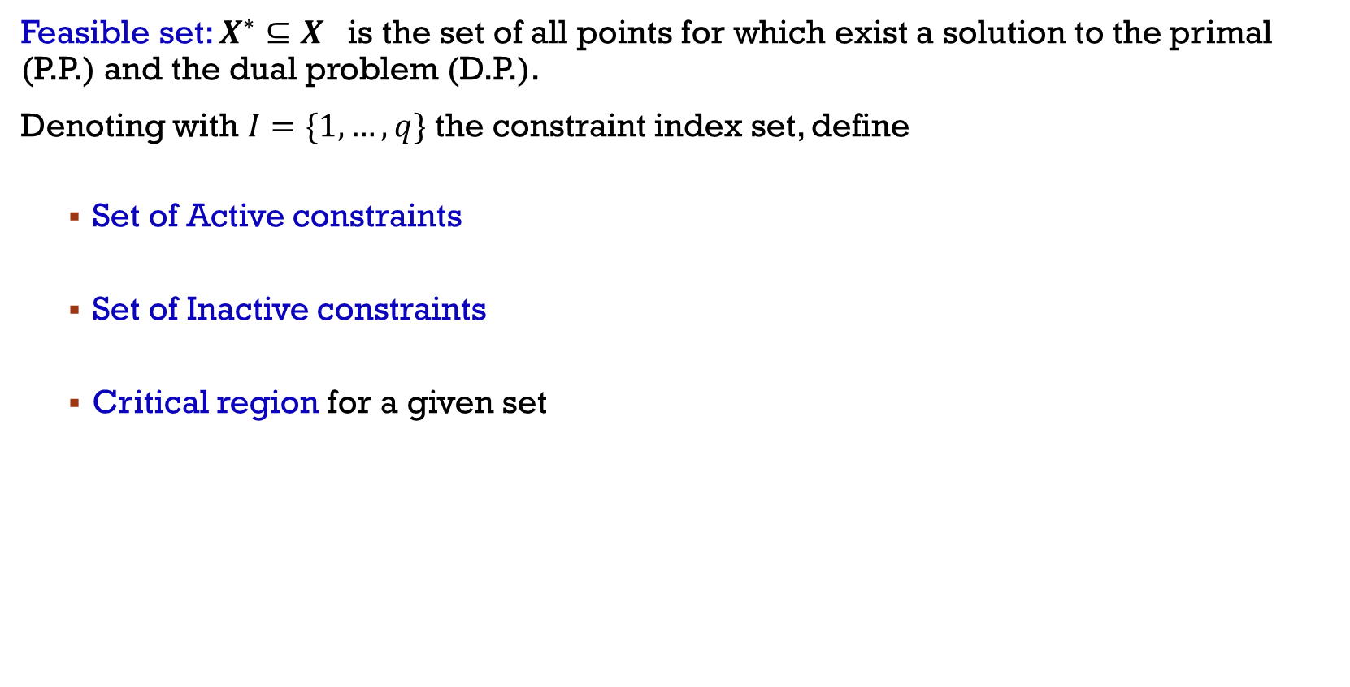
mp-LP
Feasible set: ${X^{∗}⊆X}^{}$is the set of all points for which exist a solution to the primal (P.P.) and the dual problem (D.P.).
Denoting with $I=\{1,…,q\}$ the constraint index set, define
Set of Active constraints
Set of Inactive constraints
Critical region for a given set

Slide 25




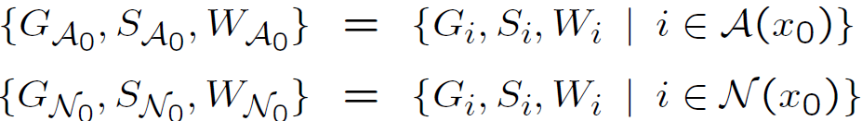
mp-LP: geometric algorithm
exploration of the parameter space X using geometric methods
requires an LP solver
Step 1: solve an LP: for an initial parameter vector
Solve P.P. & D.P.
Obtain and and matrices

Slide 26



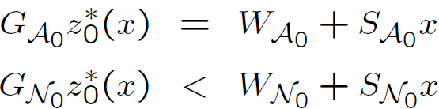

mp-LP: geometric algorithm
exploration of the parameter space X using geometric methods
requires an LP solver
Step 2: determine : , and
From the primal feasibility conditions
Compute optimizer (as a function of x)
Critical region
Compute the optimal value function using the D.P. (strong duality holds)

Slide 27




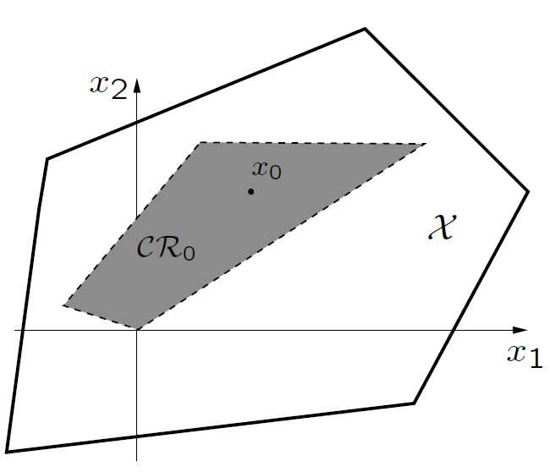


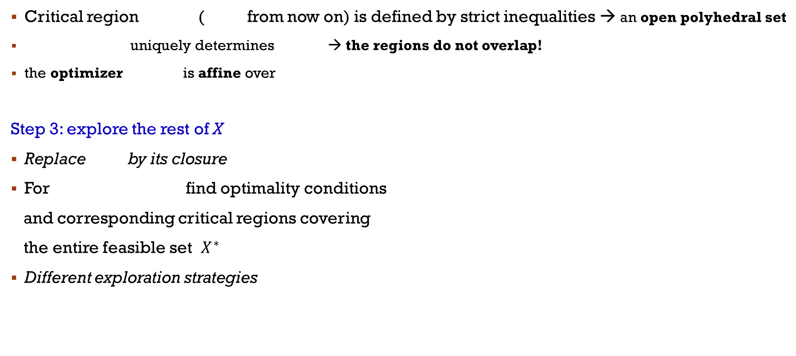
mp-LP: geometric algorithm
Critical region ( from now on) is defined by strict inequalities → an open polyhedral set
uniquely determines → the regions do not overlap!
the optimizer is affine over
Step 3: explore the rest of X
Replace by its closure
For find optimality conditions
and corresponding critical regions covering
the entire feasible set $X^{∗}$
Different exploration strategies

Slide 28
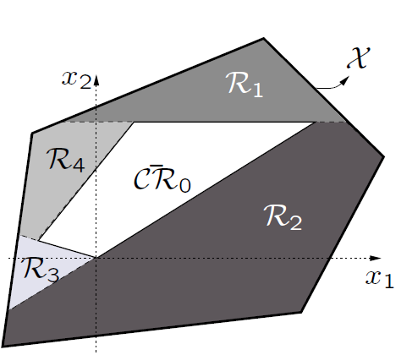
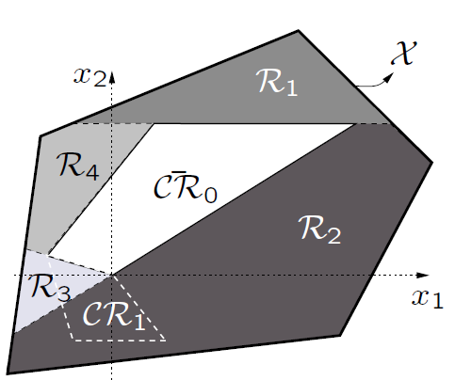
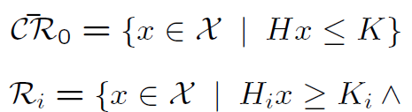


mp-LP: geometric algorithm
1st approach: reversing inequalities
Note: regions Ri are not critical regions
Proceed recursively: repeat the whole procedure for each Ri
The entire set X is explored in finite number of iterations
Problem: critical regions can be artificially divided among different Ri

Slide 29
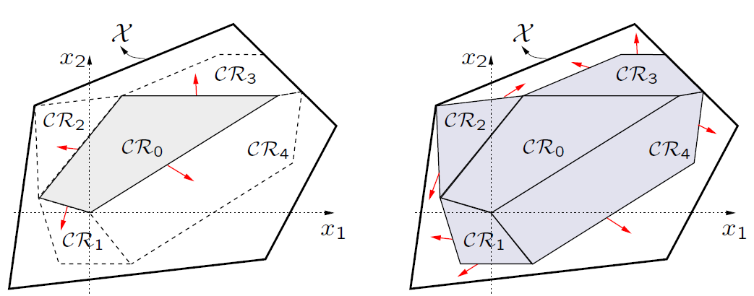
mp-LP: geometric algorithm
2nd approach: crossing the facets
For each of the facets of CR0 a point outside the region but close to the facet is selected and the procedure is repeated
Critical regions are computed “in one piece”, no artificial splitting
No formal proof that whole X is covered
In practice usually outperforms the strategy based on reversing inequalities

Slide 30
mp-LP: properties
Feasible set X* is closed and convex
If the optimal solution z* is unique for all x in X*, the optimizer function z(x) : X*→R^{m} is
Continuous
Polyhedral piecewise affine (PPWA) over X*
Affine in each CRi
If the solution is not unique, it is always possible to choose a continuous and PPWA optimizer function z*(x)
The value function J*(x): X* → R is
Convex
PPWA over X*, affine in each CRi

Slide 31
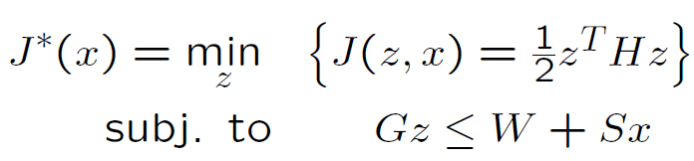
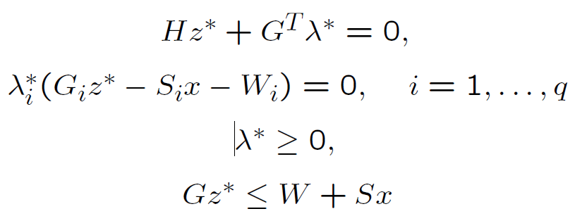
mp-QP
Formulation: multi-parametric quadratic programs of the form (Assume H>0)
KKT Conditions

Slide 32

mp-QP: geometric algorithm
exploration of the parameter space X using geometric methods
requires an QP solver
Step 1: solve an QP: for an initial parameter vector
Solve P.P. & D.P.
Obtain and and matrices

Slide 33

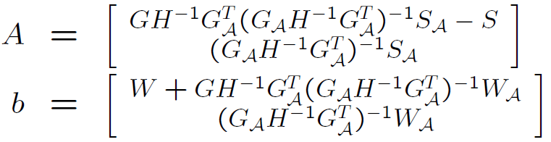

mp-QP: geometric algorithm
exploration of the parameter space X using geometric methods
requires an QP solver
Step 2: determine : , and
From the primal feasibility conditions
Since and
the optimizer function is
Critical region

Slide 34
mp-QP: geometric algorithm
Note that the function z*(x) is a uniquely defined affine function over the critical region CRA
Moreover, the critical region is a polyhedral set in the x-space
Step 3: explore the rest of X (as before..)

Slide 35
mp-QP: properties
Feasible set X* is closed and convex
The optimizer function z(x) : X*→R^{m} is
Continuous
Polyhedral piecewise affine (PPWA) over X*
Affine in each CRi
The value function J*(x): X* → R is
Continuous
Convex
polyhedral piecewise quadratic (PPWQ) (piecewise quadratic over the critical regions CRi

Slide 36
mp-MPC
MPC problems can be rewritten as LPs and QPs
→it is possible to get the parametric solution w.r.t. the space of the initial state conditions!
Since the optimizations are computed offline, online it is only necessary to evaluate the feedback control law that can be stored in a LOOK-UP Table
LIMITS: The complexity of the explicit solution (the number of regions) typically grows with the dimension of the state space ) may easily “outgrow" any practical application
How to compute the explicit solution of my MPC problem?
Make use of the MPT Toolbox

